Slide 1
Ride Analysis for Namma Yatri

Slide 2
Agenda
Business Objectives & Background
Key Findings
Recommendations
Appendix

Slide 3
Business Background & Objectives

Slide 4
Business Background
Namma Yatri plays a pivotal role in Bengaluru’s urban transport network. With its dynamic operational environment, the company must adapt to evolving demand patterns, optimize ride allocations, and ensure profitability while enhancing customer experience.
Namma Yatri seeks to optimize its operations and gain deeper insights into ride patterns, customer behavior, and operational bottlenecks.
The goal is to uncover insights that can guide decisions to improve service efficiency, maximize revenue, and enhance customer satisfaction.
Business Objectives
Identify peak demand patterns and trends.
Uncover factors influencing cancellations and driver performance
Optimise payment methods and trip durations.
Improve resource allocation and marketing strategies.

Slide 5
Key Findings

Slide 6
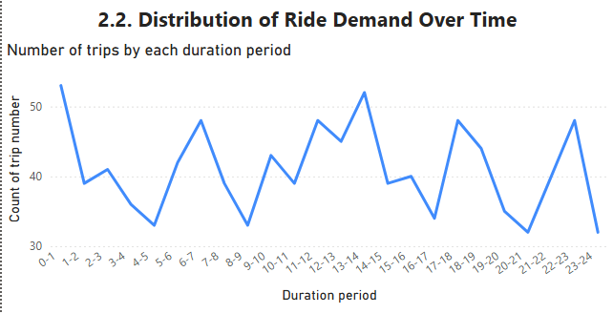
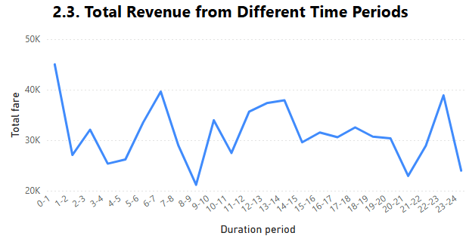
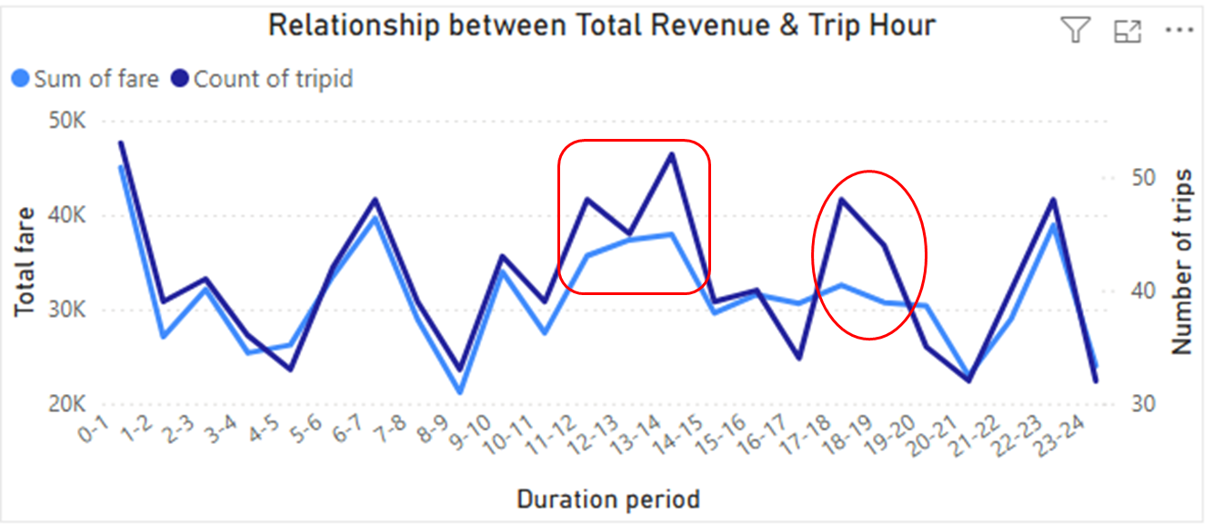
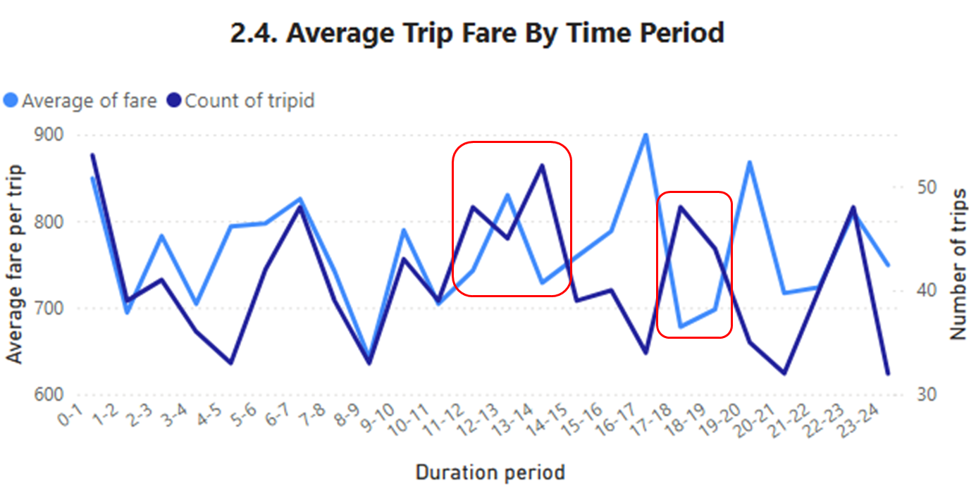
Objective 1: Identify peak demand patterns and trends.
Ride demand fluctuates over time throughout the day. The ride demand picks up significantly during 0-1, 6-7, 13-14, 17-18, 22-23. Low periods are 4-5, 8-9, 16-17, 20-21.
Similar pattern is observed for total revenue. The revenue reaches highest during periods 0-1, 6-7, 13-14, 17-18, 22-23, and gets the trough in periods 3-5, 8-9, 20-21.
There is a strong relationship between trip hour and revenue. However, there are some certain trip hours when the revenue is not as high as expected due unreasonable fare charged: 11-14, 17-19 periods.
For those periods, though ride demand is quite high however trip fare was charged quite low, leading to lower revenue than expected.

Slide 7
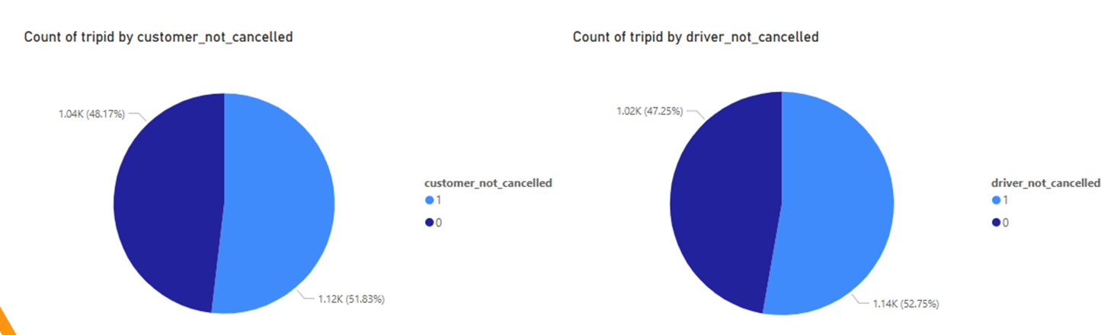
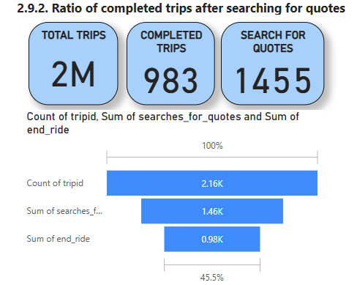
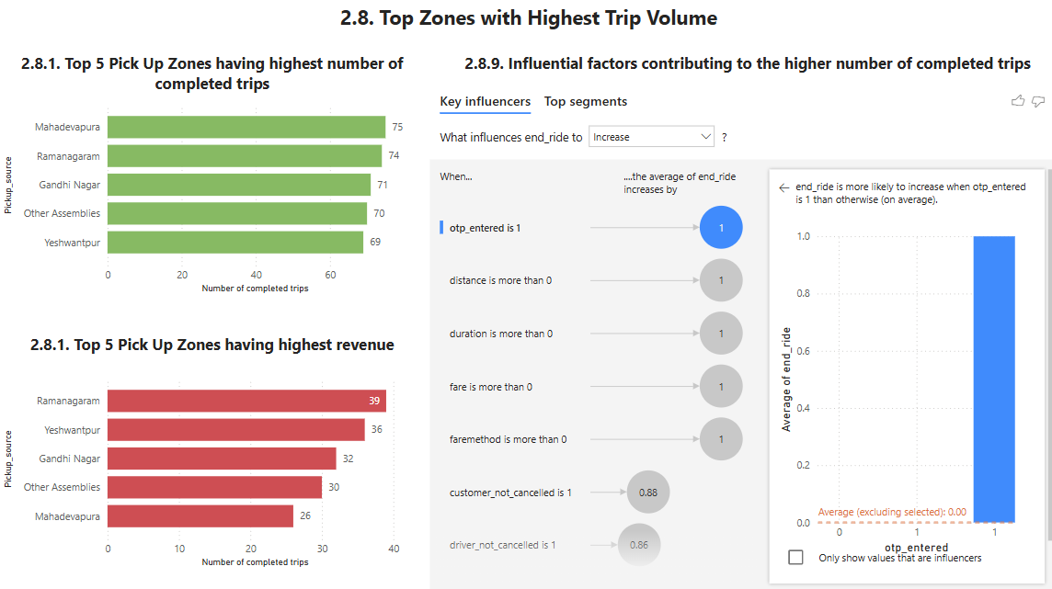
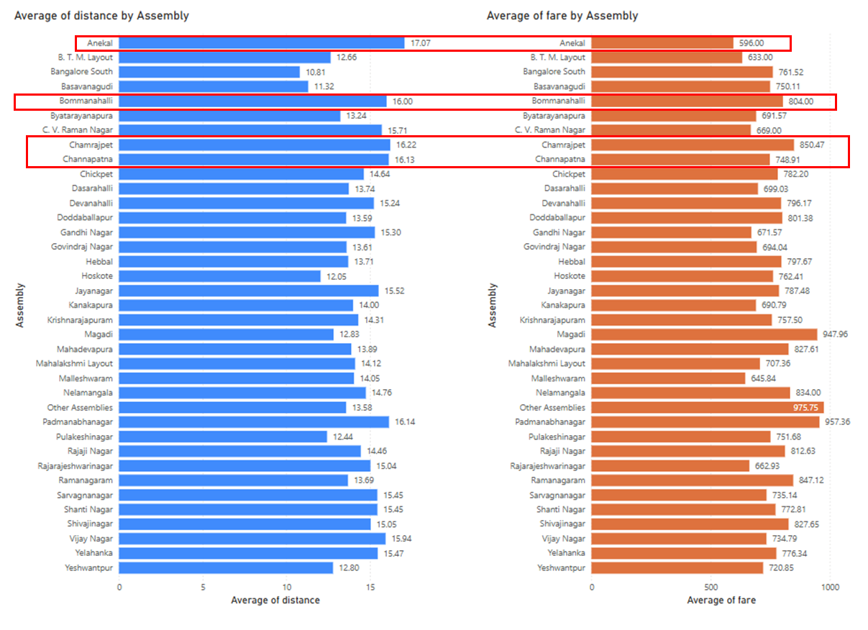
Objective 2: Uncover factors influencing cancellations and driver performance
The ratio of cancellation derived from customers and drivers are quite similar.
Around two-third of customers completing trips after searching for quotes. There is no significant change among duration period.
67%
68%
OTP_entered is the most influential factor to signify a successful deal leading to completing trips.
There is no consistent fare charging across location when benchmarking with average distance. I.e. average of distance of Anekal and Bommanahalli are similar but fare charged in Bommanahalli is much higher than Anekal. This can create disappointment for drivers between different locations.

Slide 8
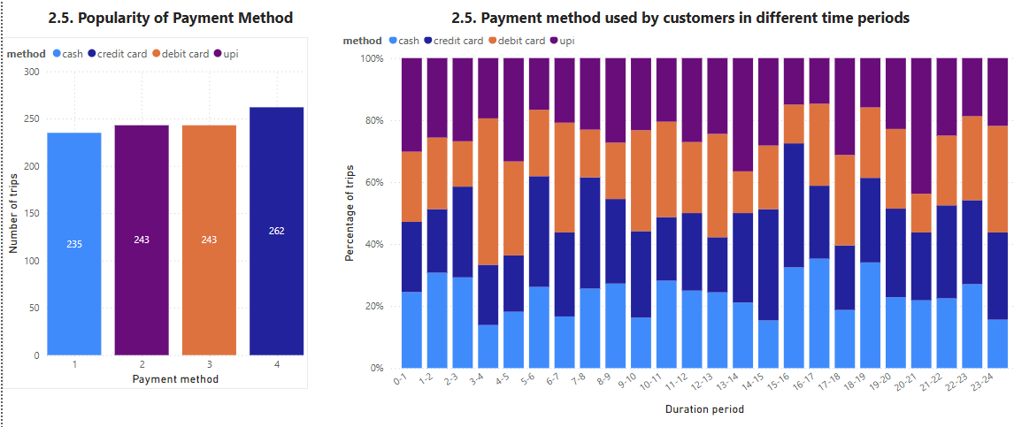
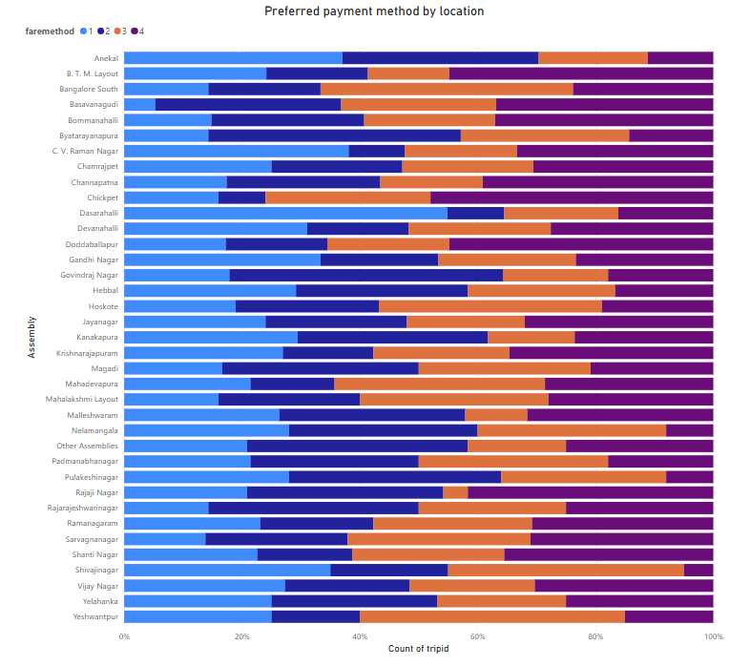
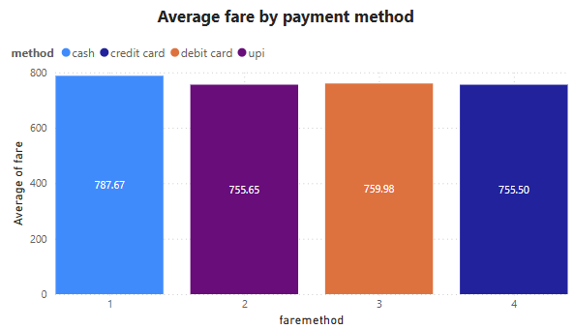
Objective 3: Optimize payment methods and trip durations.
Credit card is the most popular payment method, followed by debit card and upi. Different time periods have different preferred payment methods.
Different locations have different preferred payment method. Depending on customers’ preference of each location, we provide relevant offers to trigger customers book our ride service.
The dominance of credit card may be due to its lowest fare compared to other payment methods. Debit card and upi also have a bit higher fare charge than credit card, but still significantly lower than paying via cash.

Slide 9
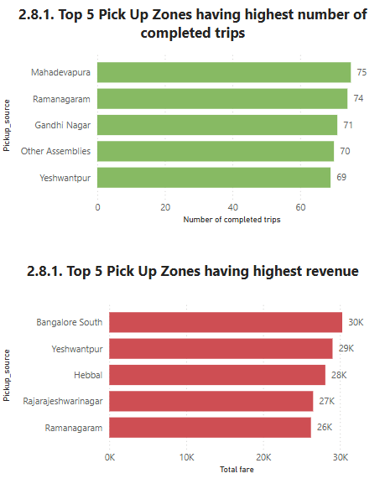
Objective 4: Improve resource allocation and marketing strategies.
High Performing Zones
Low Performing Zones
Mahadevapura, Ramanagaram, Gandhi Nagar, Yeshwantpur are top zones in terms of completed trip number (thanks to lower fare)
Bangalore South, Yeshwantpur, Hebbai, Rajarajeshwarinagar and Ramanagaram achieve higher revenue.
Bottom 6 low performing zones in terms of revenue are:
Vijay Nagar, Pulakeshinagar, Mahalashmi Layout & Nelamangaia: due to low number of trips though having quite low fare. → This might be due to low brand awareness of Namma Yattri in these regions.
Doddaballapur: due to low number of trips and really high fare charge. → This might be due to both lower brand awareness as well as high price
C. V. Raman Nagar: having high demand of trips but very low price. → Need to reconsider the pricing strategy for this region to improve the revenue against fair share.

Slide 10
Conclusions & Recommendations

Slide 11
How to improve Operational Efficiency?
Key findings
Recommendations
There are certain periods of the day that ride demand increase significantly.
The peak demand of different locations are quite different.
There is no consistent fare charging across location when benchmarking with average distance
The company should boost more drivers to meet that hide demand.
There is a need to optimize the resource efficiently to either capture the high demand in peak time and allocate drivers across locations reasonably.
Review pricing strategy across locations to ensure a fare charge for drivers or incentivize drivers in lower charge locations to encourage drivers not to cancel the trip as well as to ensure a competitiveness and fairness across locations to trigger the service usage of low demand locations where we observes significantly higher fare charged i.e. Doddaballapur.

Slide 12
Marketing and Operational Strategy Improvements
Launch more marketing campaign in the low demand locations (where having lower number of trips i.e. Vijay Nagar, Pulakeshinagar, Mahalashmi Layout & Nelamangaia, Doddaballapur) to enhance the brand awareness about Namma Yatri company in customers’ mind in those location.
Offer good price to trigger first customers trying service of the company.
Given credit card is the most popular payment method, Namma Yatri can offer some promotion campaigns to offer better price for customers to trigger demand in low period of the day.
Different locations have different preferred payment method. Depending on customers’ preference of each location, we provide relevant offers to trigger customers book our ride service.

Slide 13
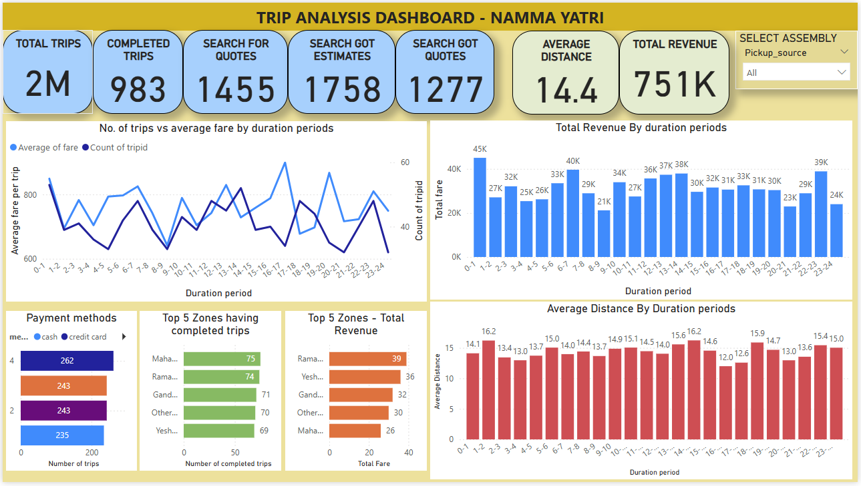
Dashboard

Slide 14
Appendix

Slide 15
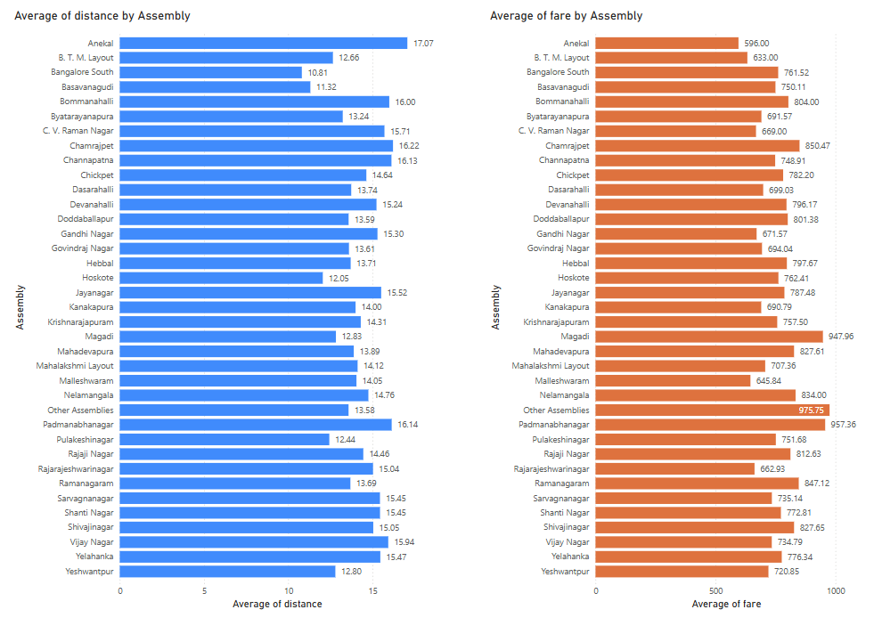
Distance vs Fare by Location
There is no consistent fare charging across location when benchmarking with average distance. I.e. average of distance of Anekal and Bommanahalli are similar but fare charged in Bommanahalli is much higher than Anekal. This can create disappointment for drivers between different locations.

Slide 16
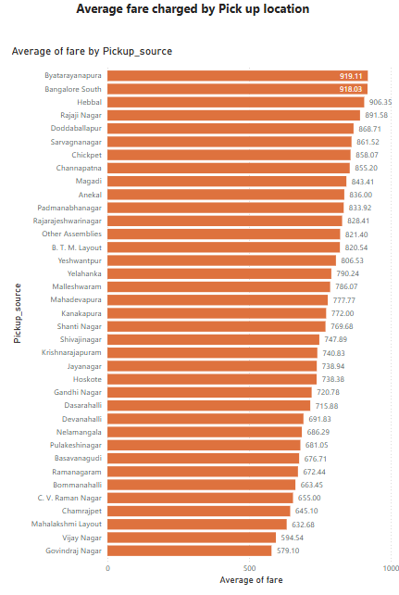
High-Performing Zones
Mahadevapura, Ramanagaram, Gandhi Nagar, Yeshwantpur are top zones in terms of completed trip number (thanks to lower fare) while Bangalore South, Yeshwantpur, Hebbai, Rajarajeshwarinagar and Ramanagaram achieve higher revenue.

Slide 17
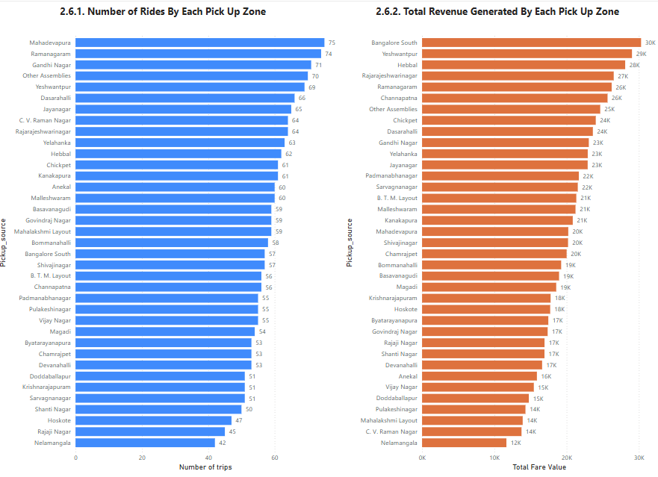
Low performing zones in total revenue

Slide 18
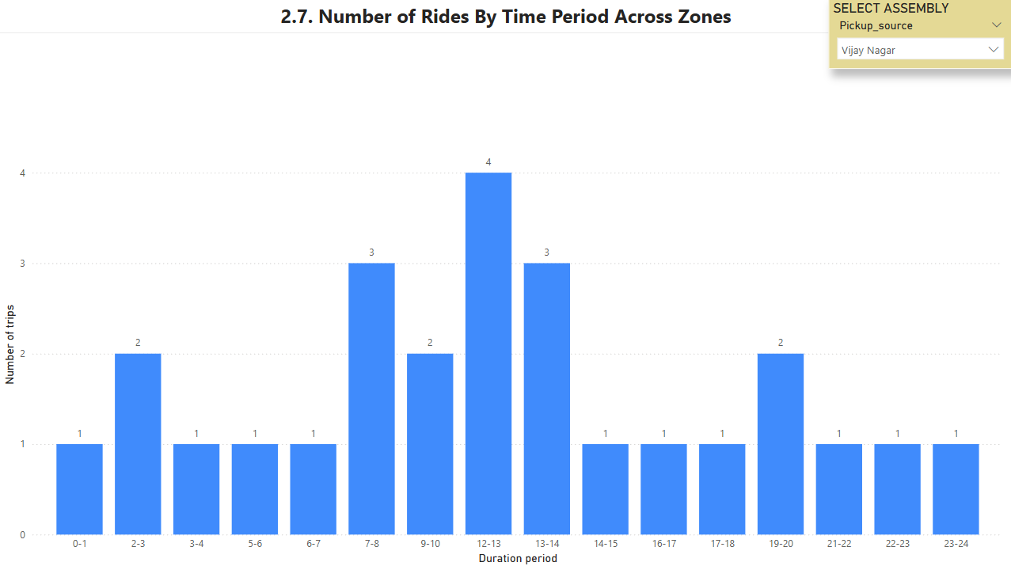
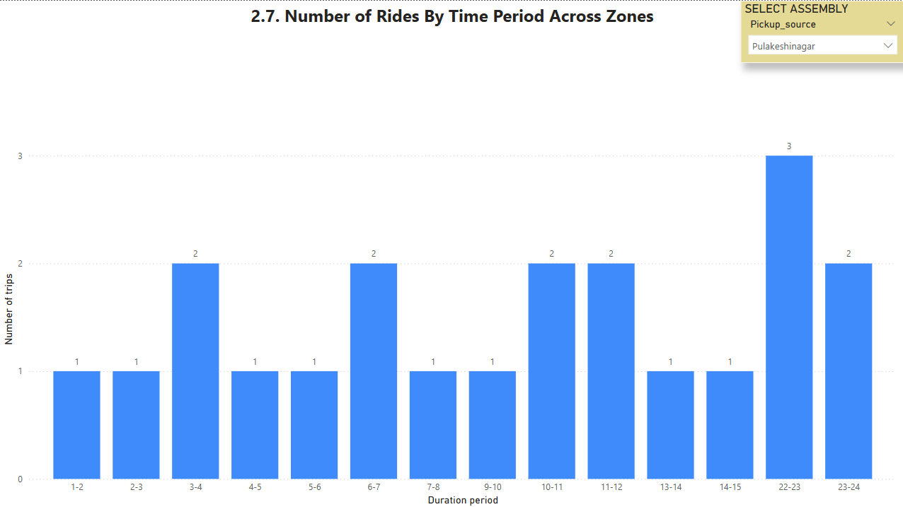
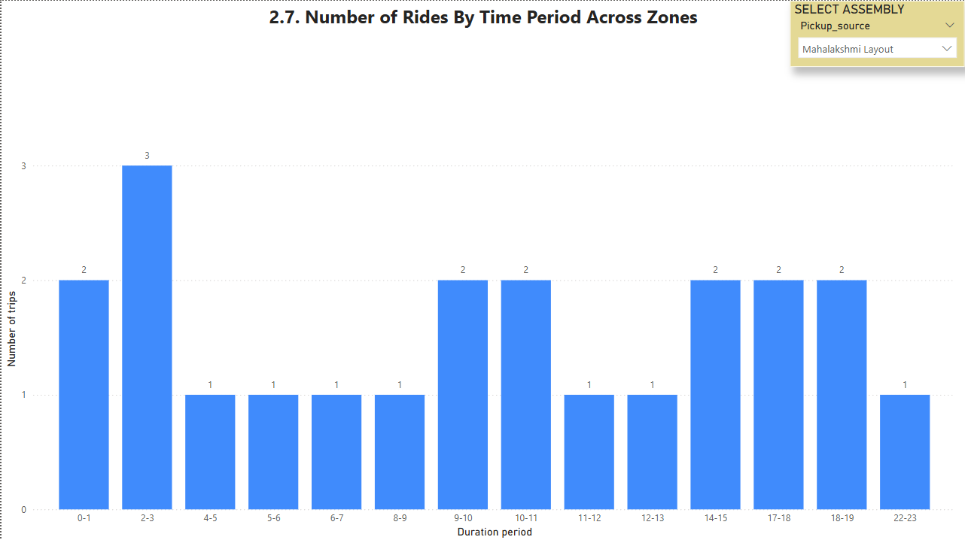
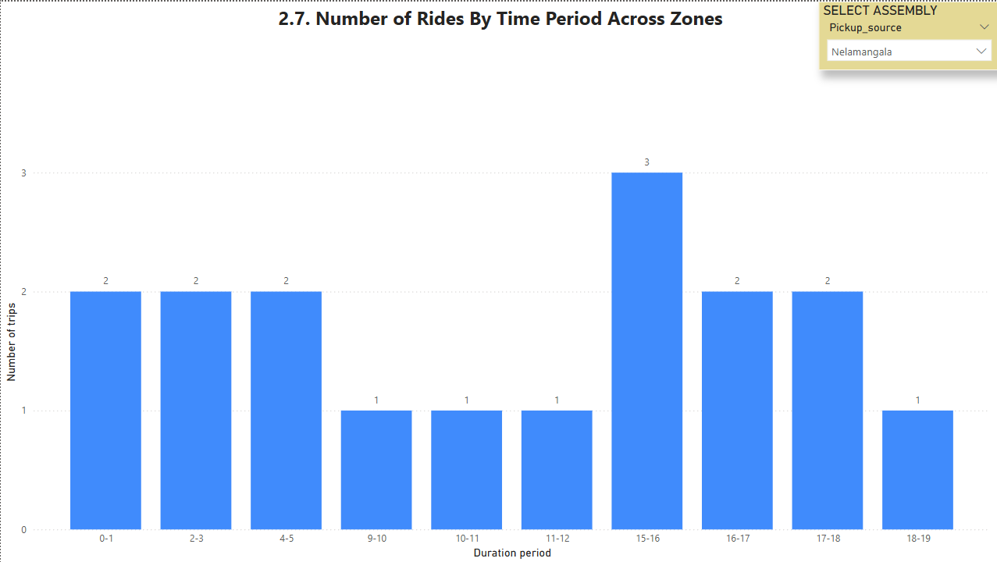
Ride Time Periods Across Zones (1)

Slide 19
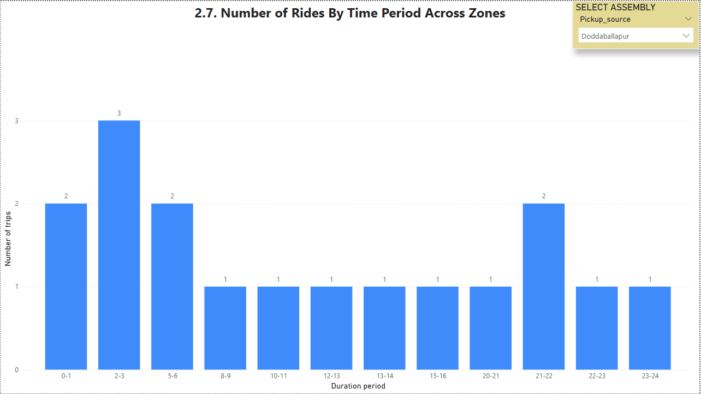
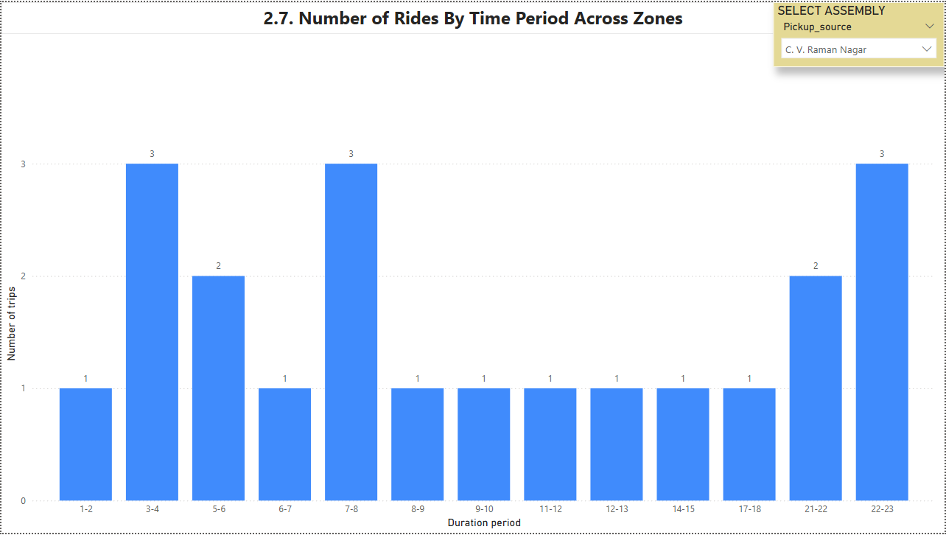
Ride Time Periods Across Zones (2)
Different pick up zones have different peak up time periods. Depending on zones, a customized plan is need to meet customers expectations of those pick up zones.

Slide 20
Thank you
Truong Tuyet Lam
lam.truongtuyet@gmail.com

